Slide 1
Chapter 2 – Elastic wave-equation and adjoint formulation

Slide 2
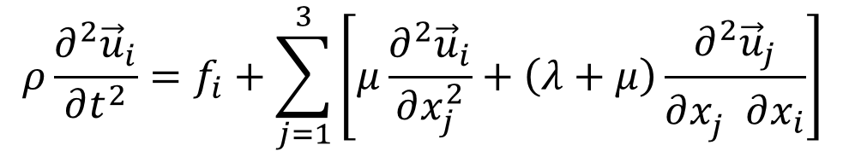
Chapter 2 – The elastic wave-equation
Navier’s Equation for an isotropic linearly-elastic solid:
where: ρ, λ and μ are density, bulk and shear moduli, respectively
u_{i} = u(x_{i},t) is the particle displacement in direction i
f_{i} is a force in direction i

Slide 3
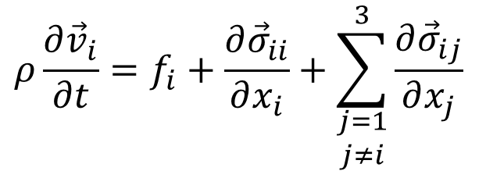
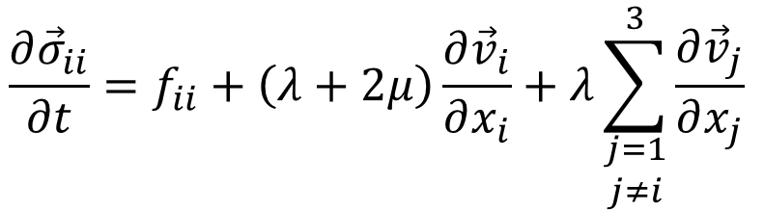
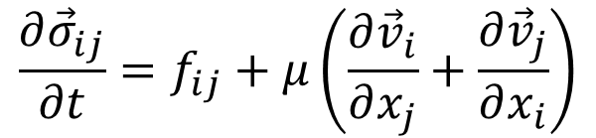
Chapter 2 – Navier as a set of first order PDEs
Particle velocities:
geophone data and
directional sources
Normal stresses:
hydrophone data
and explosive
sources
Shear stresses:
Shear sources
and data?

Slide 4
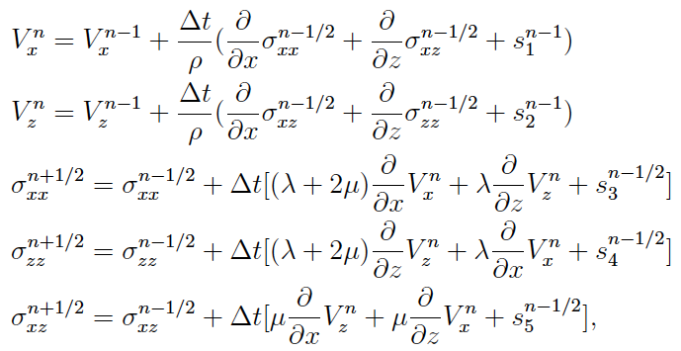
Chapter 2 – 2D PDEs with finite differences in time
Implementation using staggered grids in time:

Slide 5
Chapter 2 – Identifying time steps
Implementation using staggered grids in time:
d^{n+1}
d^{n}
s^{n}

Slide 6
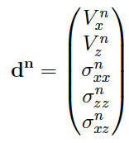
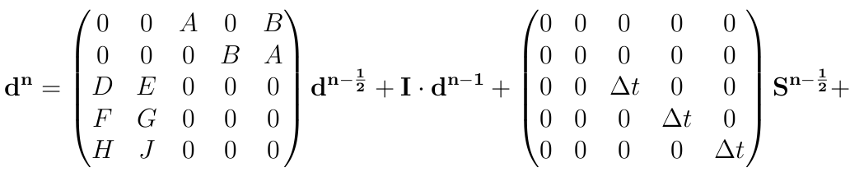
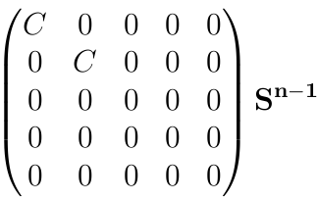
Chapter 2 – Re-ordering the terms and refining the time step
Recursive operator by time step refinement
Note that, in this approach, my data vector at time n has all wave fields at the same time step.
In this approach, I resample all vectors in terms of half time-steps.

Slide 7
Chapter 2 – Re-ordering the terms and refining the time step
Recursive operator by time step refinement
Note that, in this approach, my data vector at time n has all wave fields at the same time step.
In this approach, I resample all vectors in terms of half time-steps.

Slide 8
Chapter 2 – Linearizing the elastic wave equation
Let W be a vector that contain the solution d at all time steps n:
Because I know the relation between m and d, I can expand W(m) in a Taylor series:
Born approximation for the elastic wave equation:

Slide 9
Chapter 2 – Linearization in the model space
Born approximation for the elastic wave equation
Visually, what does this mean?
m | = | m₀ | + | Δm
Total density | Background density | Density perturbation

Slide 10
Chapter 2 – Linearization in the data space

Slide 11
Chapter 2 – Linearization in the data space

Slide 12


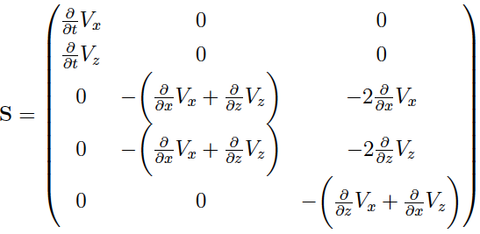
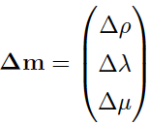
Chapter 2 – Linearization in the data space

Slide 13
Chapter 2 – Linearization in the data space
model perturbation

Slide 14
Chapter 2 – Linearization in the data space
scattering matrix

Slide 15
Chapter 2 – Linearization in the data space
wave-equation modeling operator

Slide 16
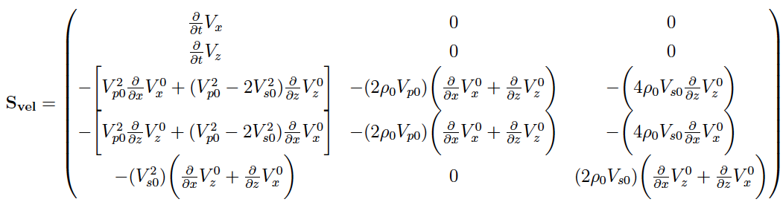
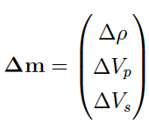
Chapter 2 – Linearization in the data space
Changing the model space to density and seismic velocities:

Slide 17
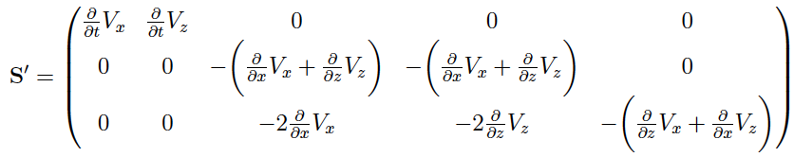
Chapter 2 – Adjoint of the linear Born operator
The reason I want to have my wave equation as a linear relation between data space and model space, is to go from here:
To here:

Slide 18
Chapter 2 – Adjoint of the linear Born operator
The reason I want to have my wave equation as a linear relation between data space and model space, is to go from here:
To here:
data difference or data residual

Slide 19
Chapter 2 – Adjoint of the linear Born operator
The reason I want to have my wave equation as a linear relation between data space and model space, is to go from here:
To here:
adjoint propagation of the wavefield

Slide 20
Chapter 2 – Adjoint of the linear Born operator
The reason I want to have my wave equation as a linear relation between data space and model space, is to go from here:
To here:
scattering matrix ➔ background data

